Slide 1



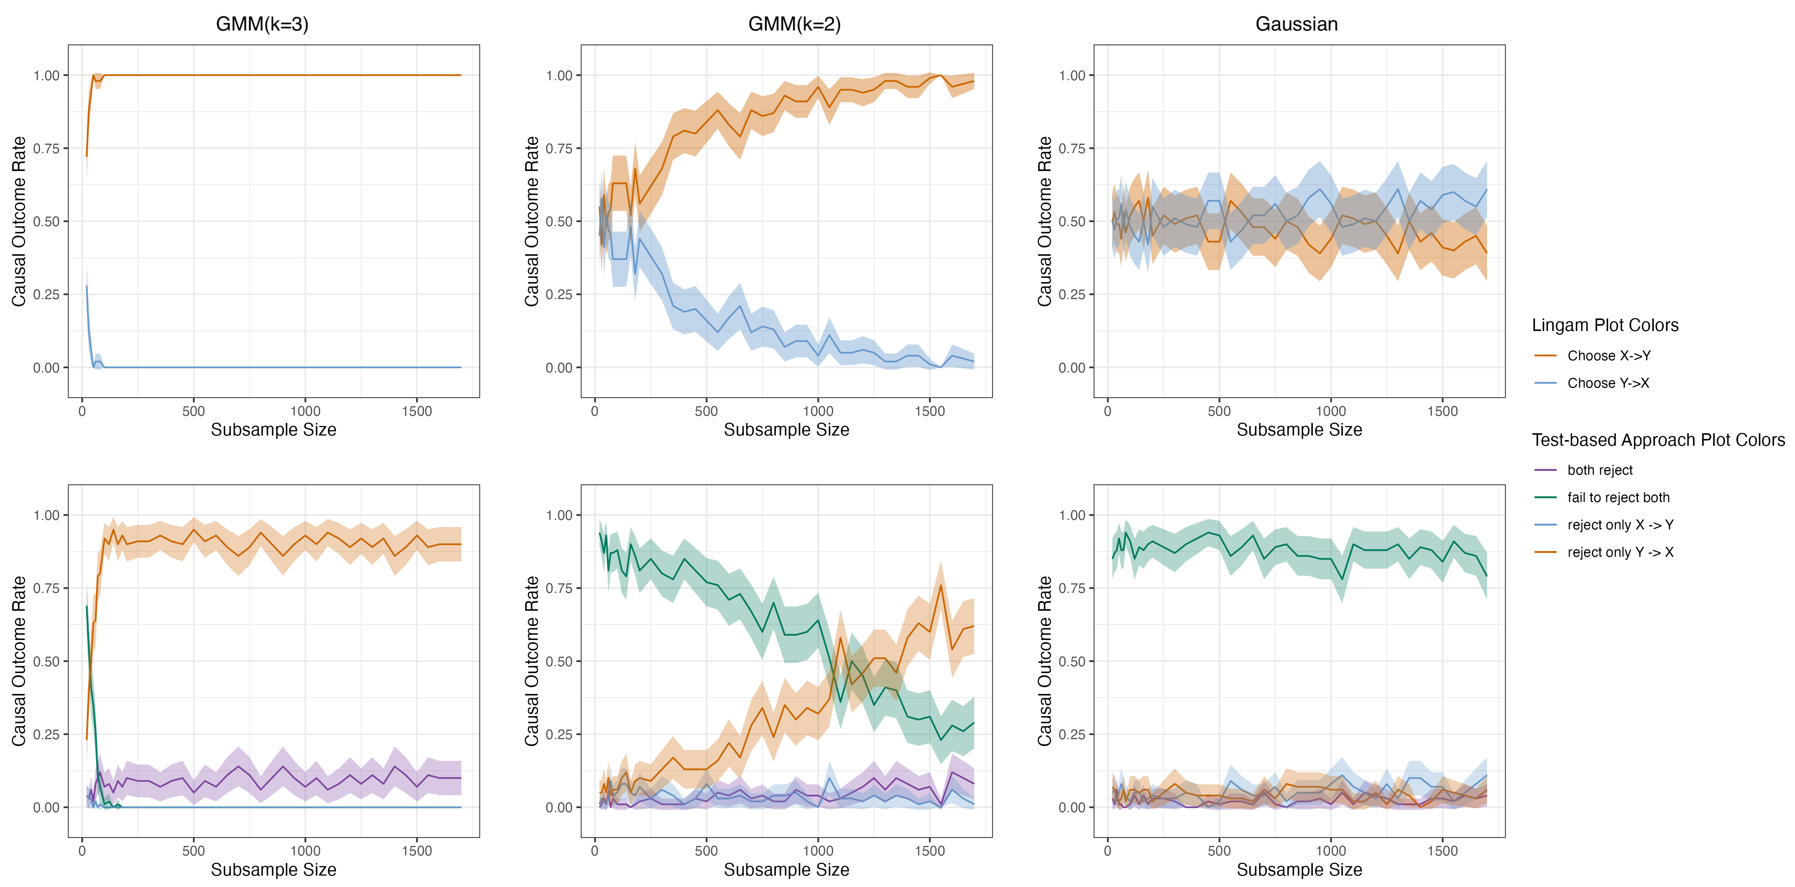
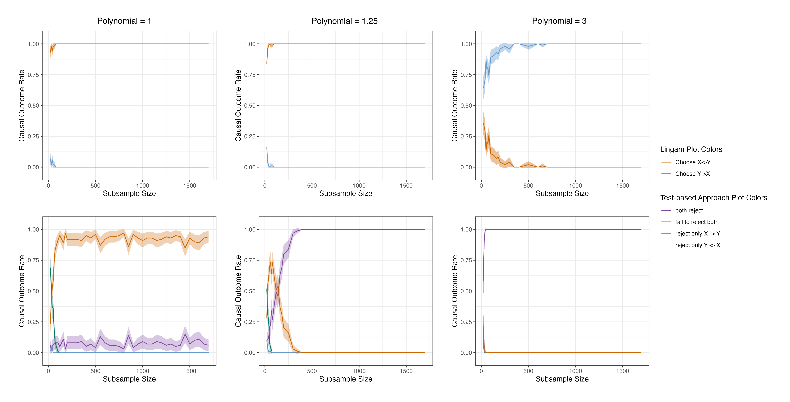
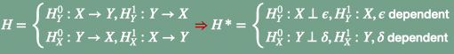
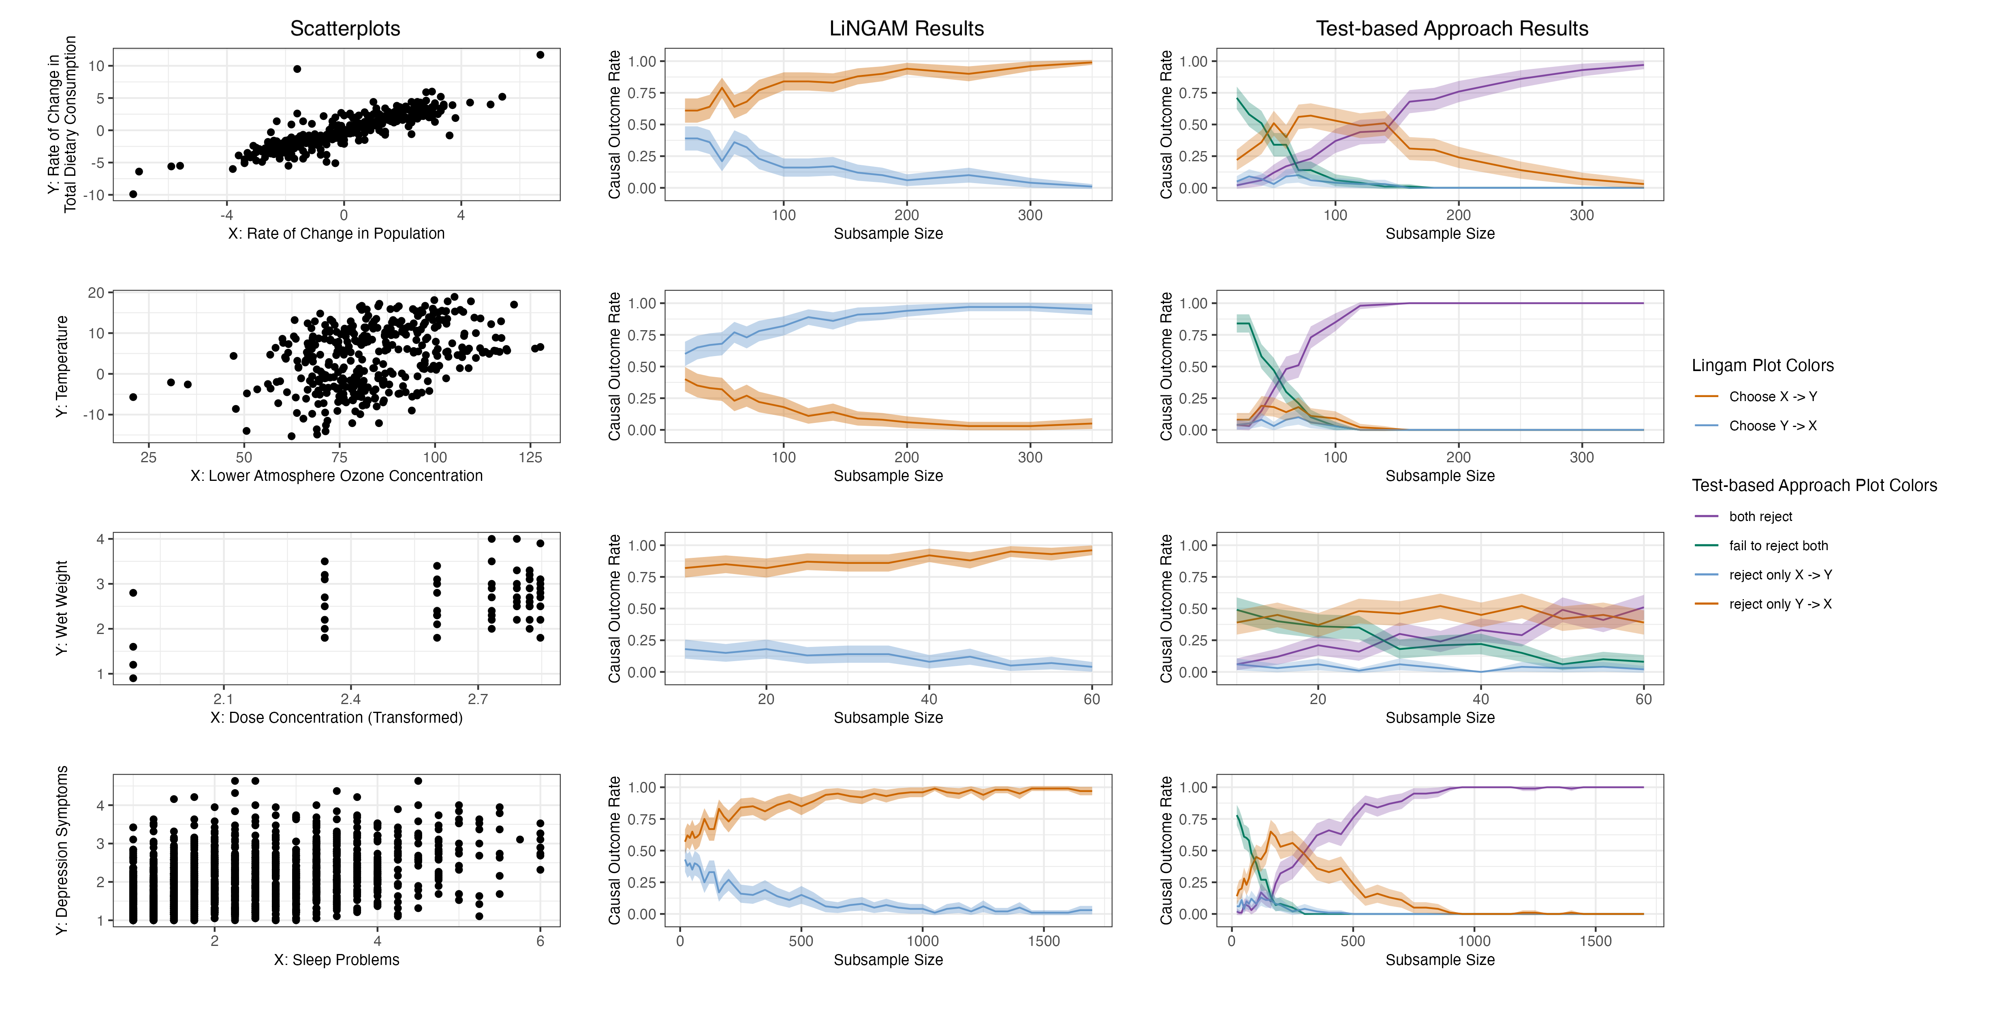
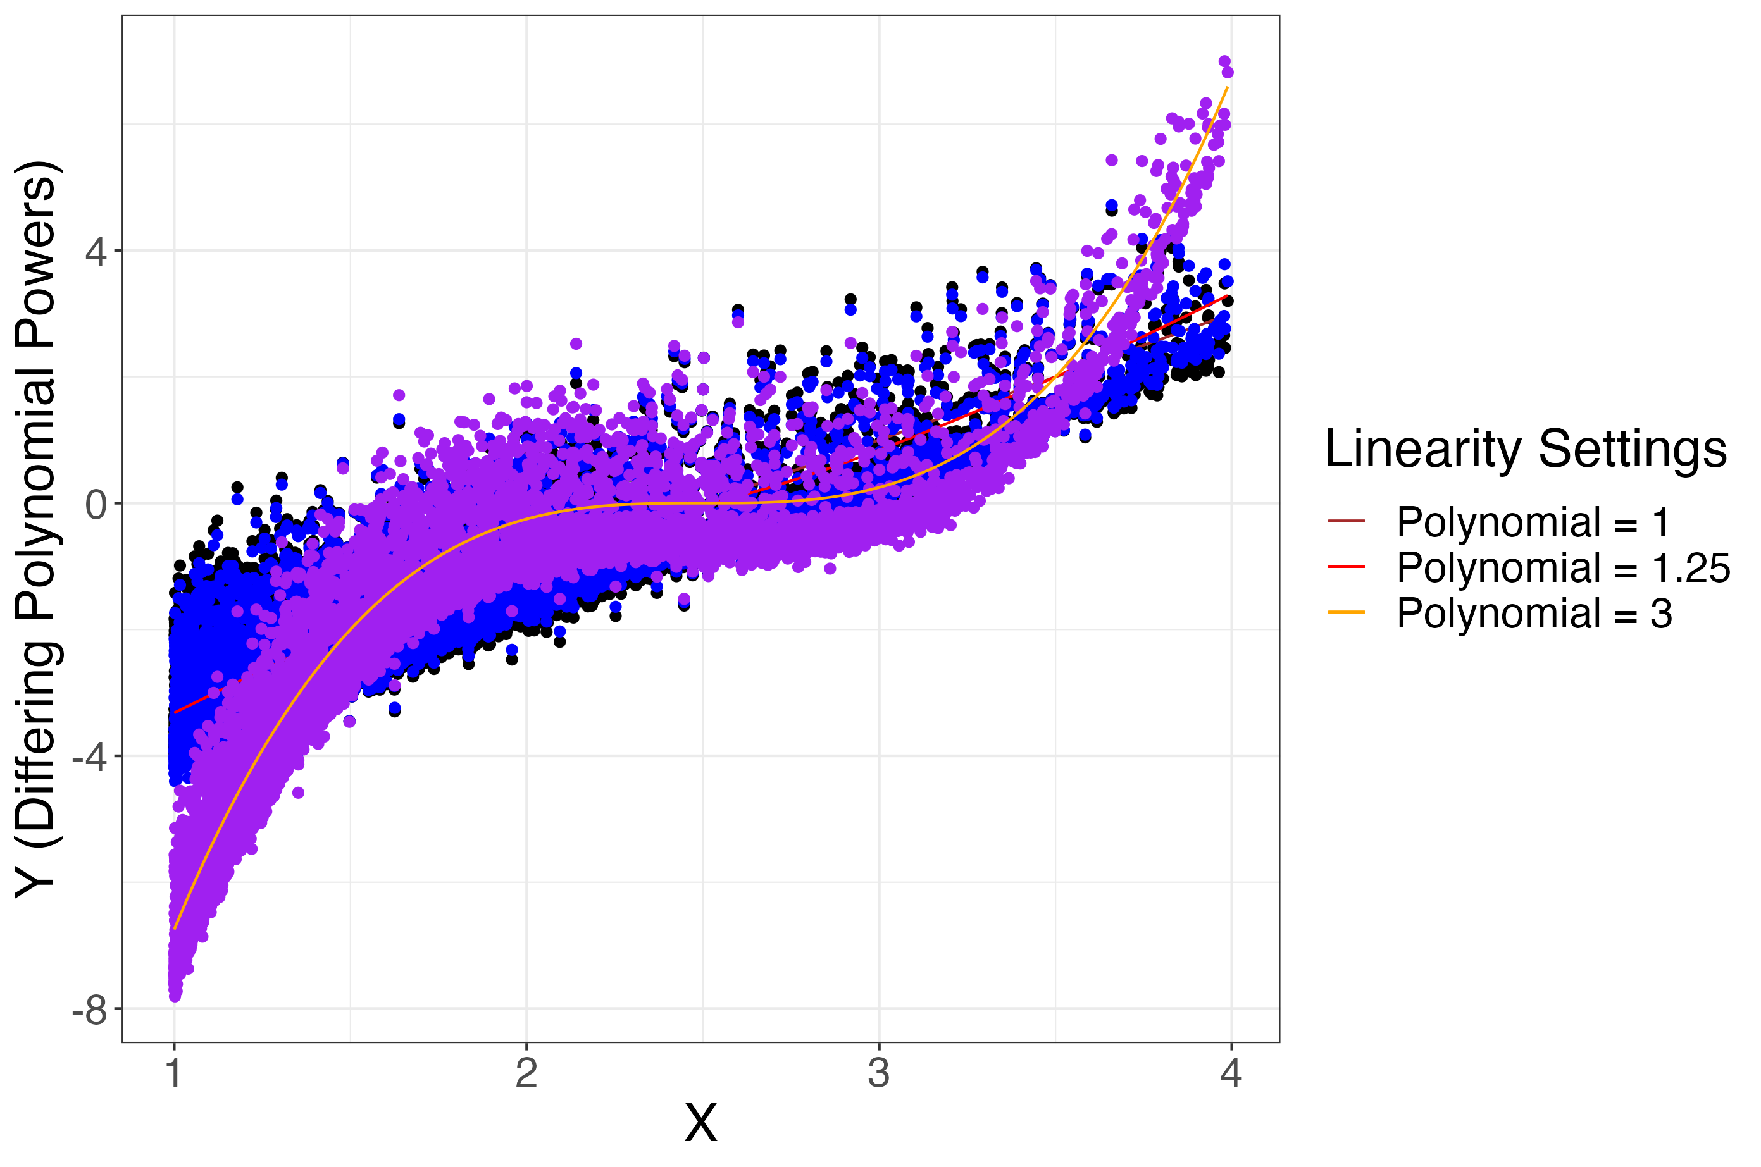
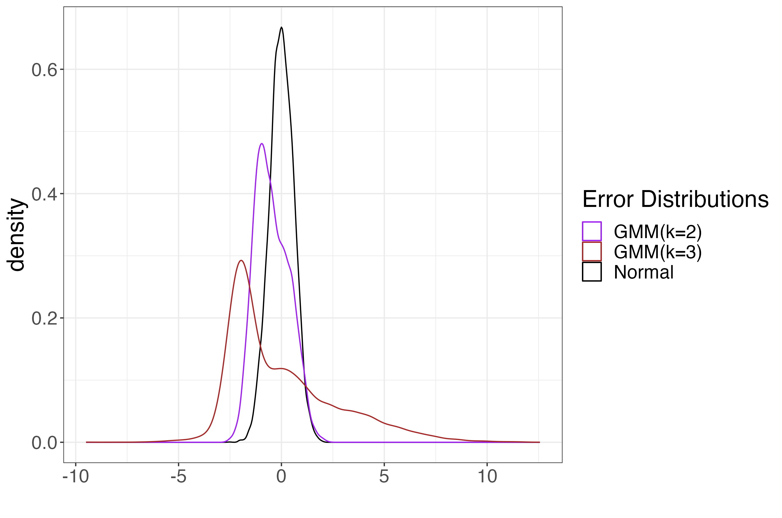

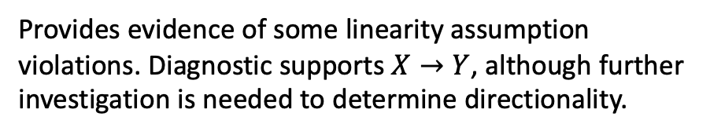
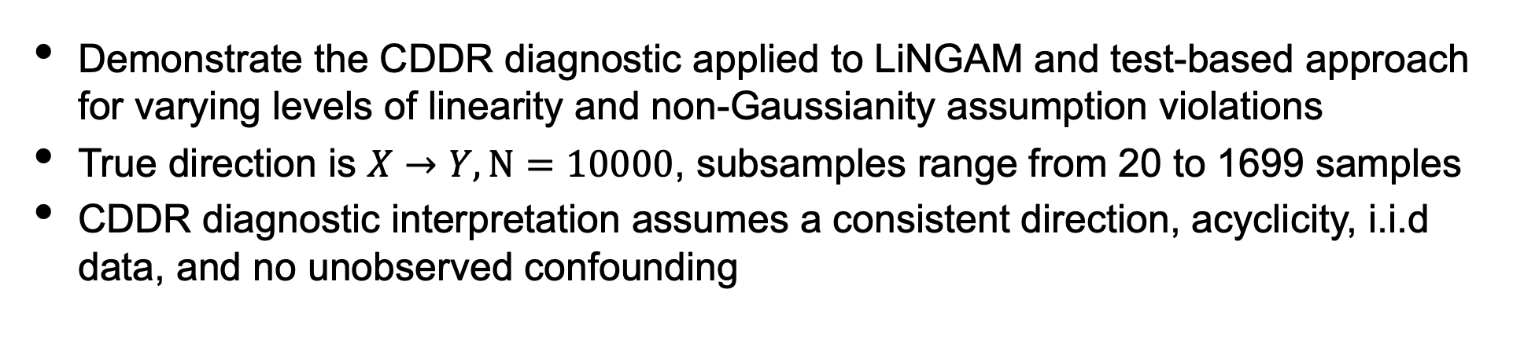
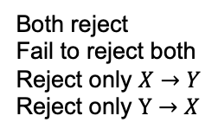


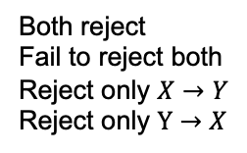
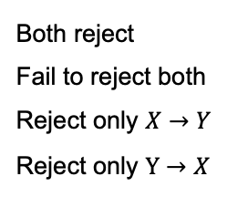
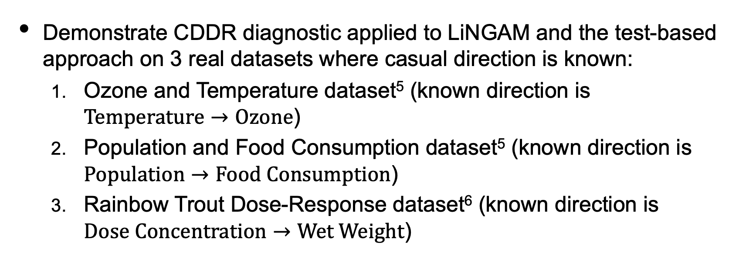

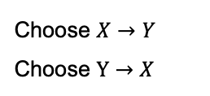
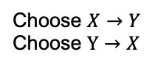

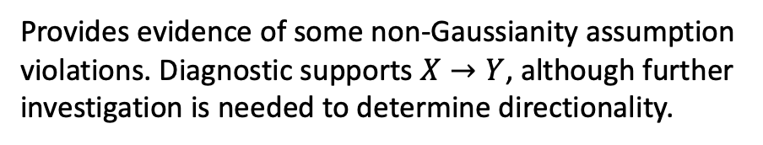
Towards Causal Discovery with Statistical Guarantees
S. Prakash^{1*}, F. Xia², E. Erosheva¹
1 University of Washington, Seattle, Washington; *shreyap1@uw.edu
2 University of California San Francisco, San Francisco, California
INTRODUCTION
RESULTS
Simulation Results
Functional causal discovery methods aim to infer a causal directionality from the data using distributional assumptions
Assumptions are often strong but there exists no diagnostic tool to assess both assumption violations and their impact on the directionality
Interplay between sample size and assumption violations may impact the inferred directionality
Small sample sizes may lead to indeterminate results due to insufficient information
Large sample sizes can provide enough data for methods to detect subtle assumption violations with confidence, potentially obscuring the directional signal
Propose the Causal Direction Detection Rate (CDDR) diagnostic to address this need
CDDR Diagnostic Interpretation
Strong evidence in favor of non-Gaussianity holding.
Method | Color | Description
LiNGAM with HSIC | orange (CDDR) | Favors $X→Y$ (correct direction)
 | blue | Favors $Y→X$ (incorrect direction)
Test-based Approach | orange (CDDR) | Favors $X→Y$ (correct direction)
 | blue | Favors $Y→X$ (incorrect direction)
 | purple | Indicates linearity assumption violation
 | green | Indicates small sample size or non-Gaussianity assumption violation
LiNGAM Plot Colors
Choose $X→Y$
Choose $Y→X$
Strong evidence of non-Gaussianity assumption violations. Inconclusive direction.
Simulation Conclusions
Test-based Approach Plot Colors
METHODS
Both reject
Fail to reject both
Reject only $X→Y$
Reject only $Y→X$
Casual Discovery Diagnostic: Causal Direction Detection Rate (CDDR)
Measures uncertainty in causal direction as a function of sample size
Flexible to any functional causal discovery method
Is consistent and exhibits CLT properties under some assumptions
Linearity assumptions violations:
CDDR diagnostic applied to LiNGAM does not provide much information
CDDR diagnostic applied to the test-based approach provides information about the existence and extent of violations while still favoring a directionality
Non-Gaussianity assumption violations:
CDDR diagnostic provides information about the existence and extent of violations while favoring a directionality
Strong evidence no assumption violations and direction being $X→Y$
Provides evidence of some non-Gaussianity assumption violations. Diagnostic supports $X→Y$, although further investigation is needed to determine directionality.
LiNGAM Plot Colors
Causal Discovery Methods
Real Data Setup
Choose $X→Y$
Choose $Y→X$
Linear Non-Gaussian Acyclic Model (LiNGAM)¹ and the Test-based Approach
Additive Noise Models (ANM)
Post-Nonlinear Causal Model (PNL)
Demonstrate CDDR diagnostic applied to LiNGAM and the test-based approach on 3 real datasets where casual direction is known:
Ozone and Temperature dataset⁵ (known direction is $Temperature→Ozone$)
Population and Food Consumption dataset⁵ (known direction is $Population→Food Consumption$)
Rainbow Trout Dose-Response dataset⁶ (known direction is $Dose Concentration→Wet Weight$)
Cannot say much about linearity assumption violations
Test-based
Test-based Approach Plot Colors
Uses hypothesis tests to determine the causal direction:
Compares p-value estimated from $H$* to significance level
Both reject
Fail to reject both
Reject only $X→Y$
Reject only $Y→X$
Assumes
Uses linear regression to decide between
$X→Y⇒Y=βX+ε, X⊥ε$
$Y→X⇒X=γY+η, Y⊥η$
Real Data Results
Provides evidence of some linearity assumption violations. Diagnostic supports $X→Y$, although further investigation is needed to determine directionality.
Strong evidence of linearity assumption violations. Inconclusive direction.
Linearity
Non-gaussianity
I.I.D data
Acyclicity
No unobserved confounding
Real Data Conclusions
Ozone and Temperature dataset
CDDR diagnostic indicates that LiNGAM favors incorrect direction due to assumption violations
CDDR diagnostic applied to the test-based approach indicates moderate to severe linearity assumption violations and supports an inconclusive direction
Population and Food Consumption dataset
CDDR diagnostic indicates both methods favor correct direction
CDDR diagnostic applied to the test-based approach provides some evidence of linearity assumption violations
Rainbow Trout Dose-Response dataset
CDDR diagnostic for both methods provides support for the correct direction
CDDR diagnostic for test-based approach only detects minor linearity assumption violations due to the inevitable non-linearities in real data.
Compares “test-statistics” (e.g. mutual information) between directions
LiNGAM Plot Colors
LiNGAM
Choose $X→Y$
Choose $Y→X$
Test-based Approach
Plot Colors
Both reject
Fail to reject both
Reject only $X→Y$
Reject only $Y→X$
SIMULATION SETUP
Demonstrate the CDDR diagnostic applied to LiNGAM and test-based approach for varying levels of linearity and non-Gaussianity assumption violations
True direction is $X→Y, N=10000$, subsamples range from 20 to 1699 samples
CDDR diagnostic interpretation assumes a consistent direction, acyclicity, i.i.d data, and no unobserved confounding
CONTRIBUTIONS
REFERENCES
Developed the first diagnostic tool for causal discovery to evaluate assumption violations as a function of sample size
Can be applied to any bivariate functional causal discovery method
CDDR Diagnostic is an especially effective diagnostic tool when paired with a causal discovery method that provides more than just a deterministic direction (e.g. test-based approach)
1 Shimizu et al. Journal of Machine Learning Research. 2006.
2 Sen & Sen. Biometrika. 2014.
5 Mooji et al. Journal of Machine Learning Research. 2016.
6 Ritz et al. PloS one. 2015.
Simulation settings for varying levels of linearity. Polynomial = 1 corresponds to linear setting. Polynomial = 1.25 corresponds to slightly nonlinear. Polynomial = 3 corresponds to nonlinear.
Simulation settings for varying levels of non-Gaussianity. GMM(k=3) corresponds to non-Gaussian. GMM(k=2) corresponds to slightly non-Gaussian. Gaussian corresponds to Gaussian setting.

